Slide 1


2025-12-10
2D Action-RPG Project
Zelda Reloaded
(Unity 6000.2.8f)

Slide 2





Reproduction
Requirements
(Version 6000.2.8f1)
Packages
Cinemachine
TextMesh Pro
Project folder

Slide 3




High-level Architecture
Game Managers
The core functionality is handled by several key managers, including GameManager, StatsManager, InventoryManager, and ExperienceManager.
Overview of game architecture and systems structure
Data Components
Essential data is represented by ScriptableObjects like SkillSO and ItemSO, defining key attributes and behaviors in the game.
World & Spawning
The world is dynamically managed through components like SpawnManager and SpawnArea, ensuring smooth gameplay experiences and environmental interactions.

Slide 4
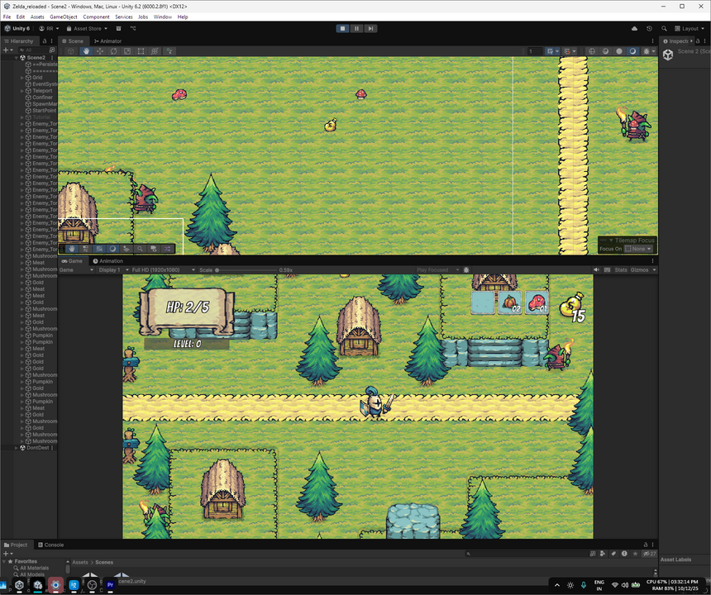
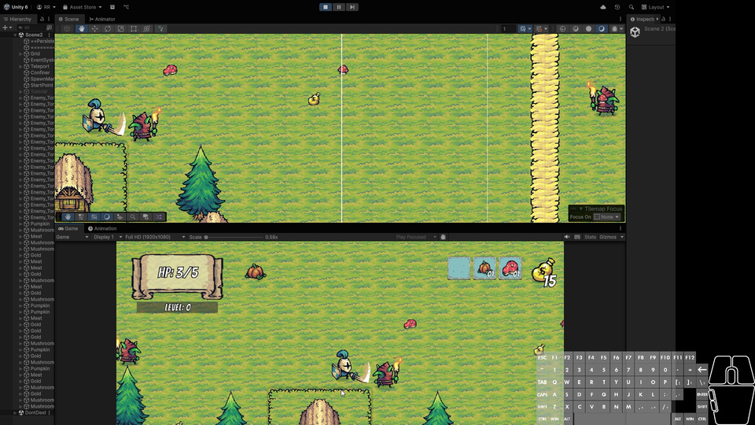
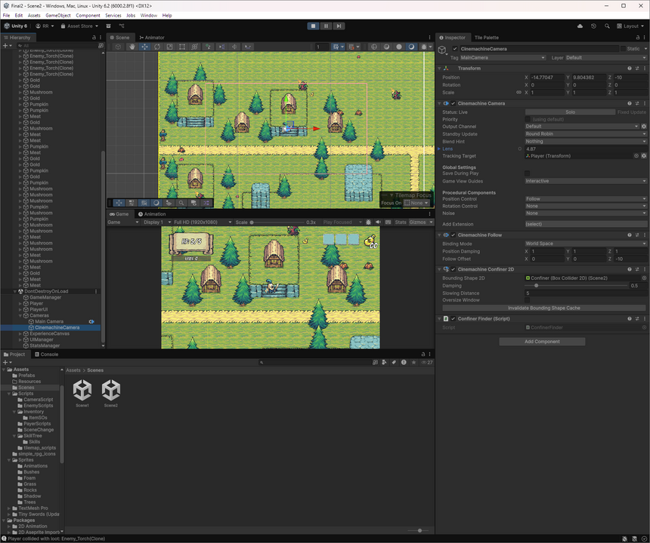
Movement & Elevation Mechanics
Player Movement
Knockback
Elevation Control
Rigidbody2D moves based on input directions.
Character reacts to external forces affecting movement.
Transitioning between elevation levels using triggers.

Slide 5
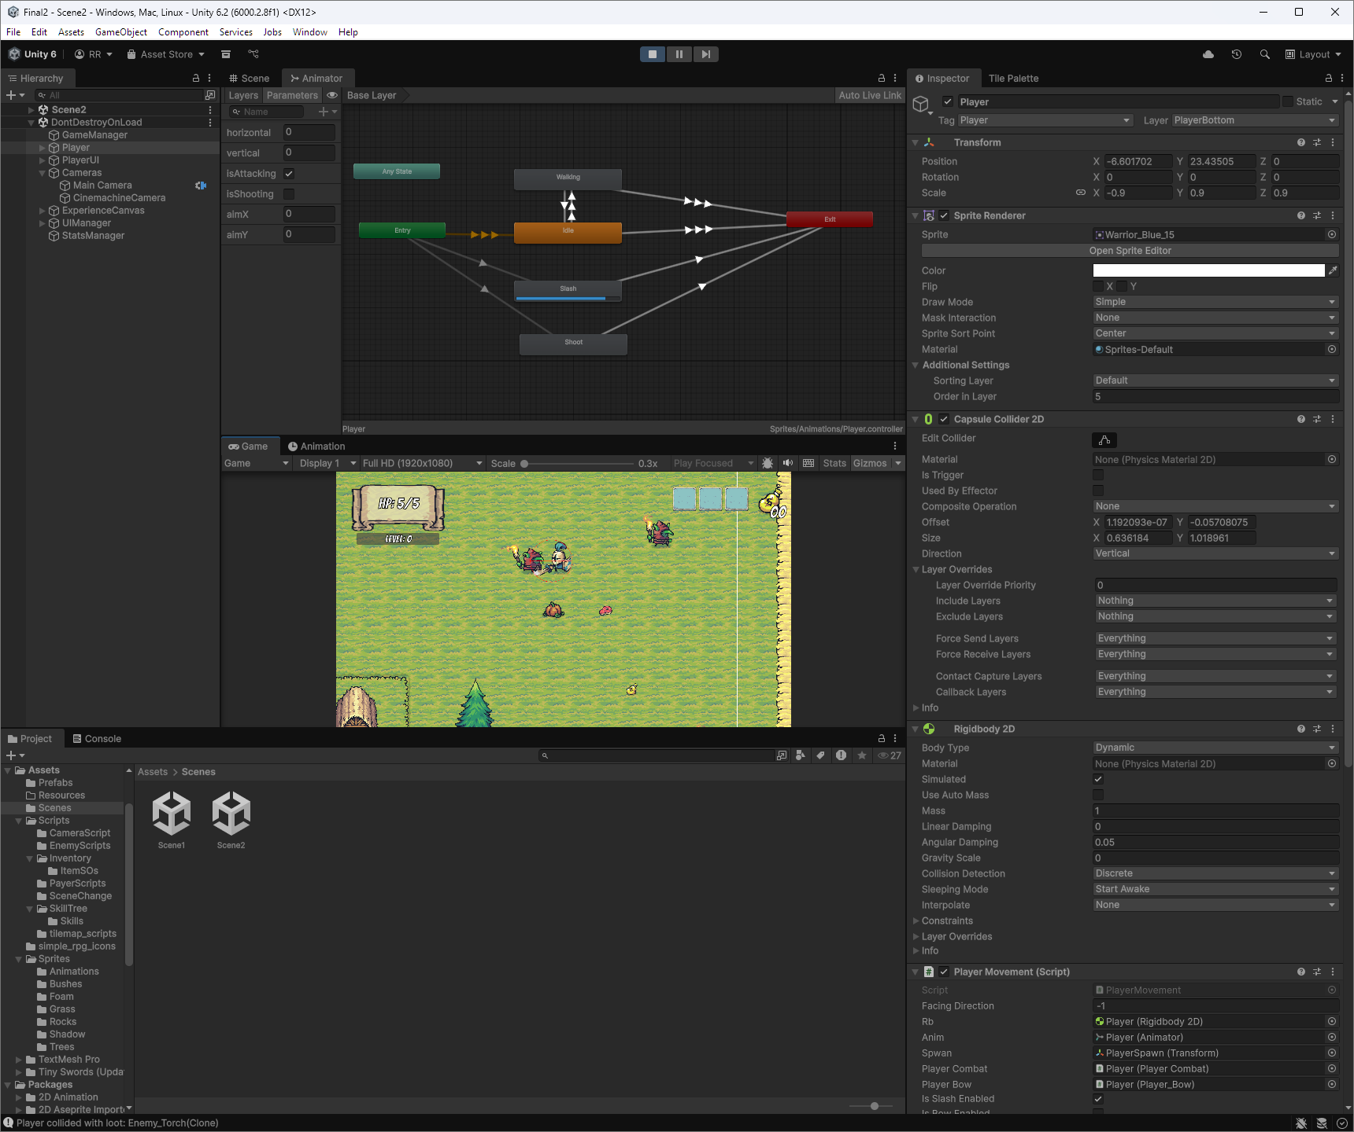
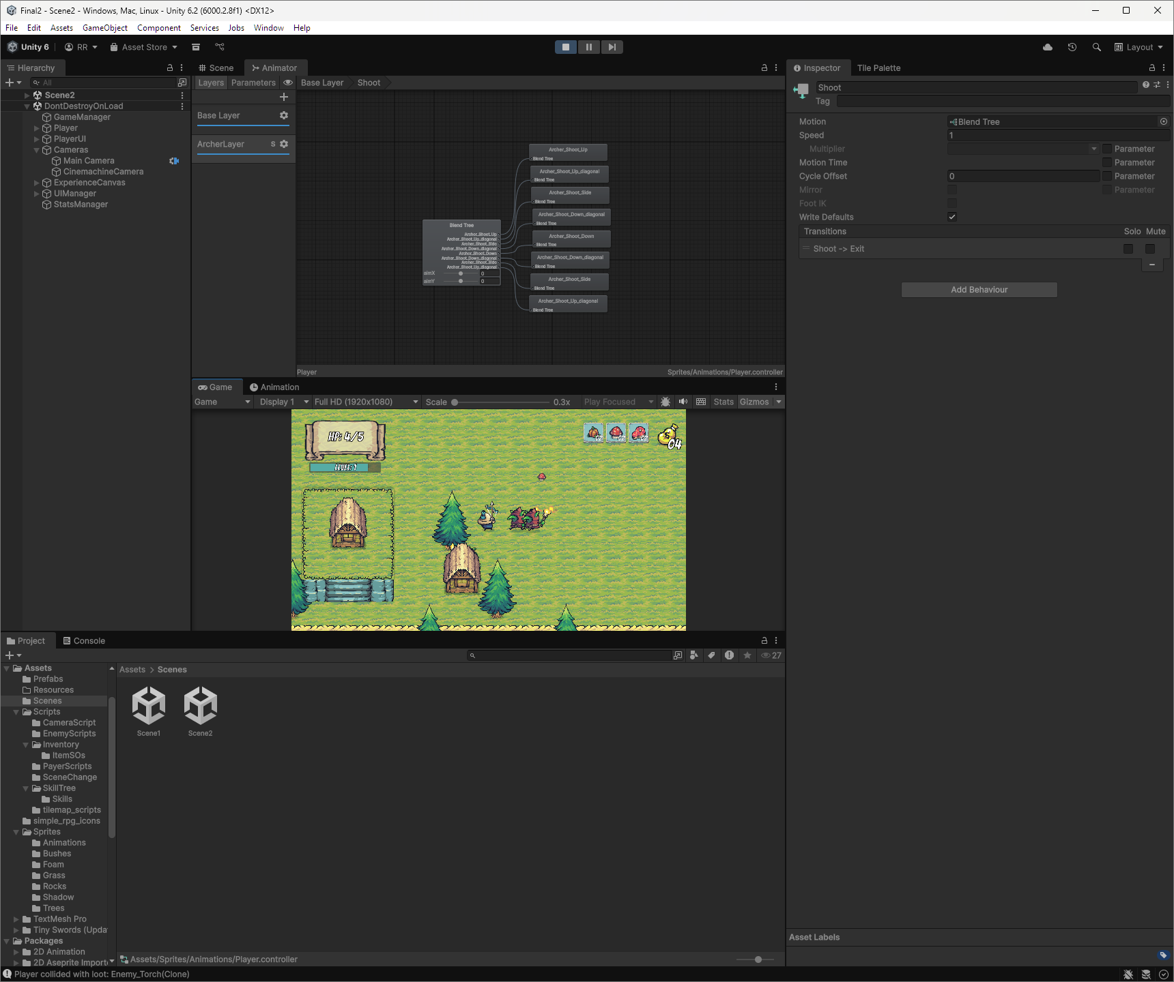
Combat Systems Explained
Melee Combat
Ranged Combat
Uses OverlapCircleAll for hit detection.
Utilizes launch points and Arrow physics.

Slide 6
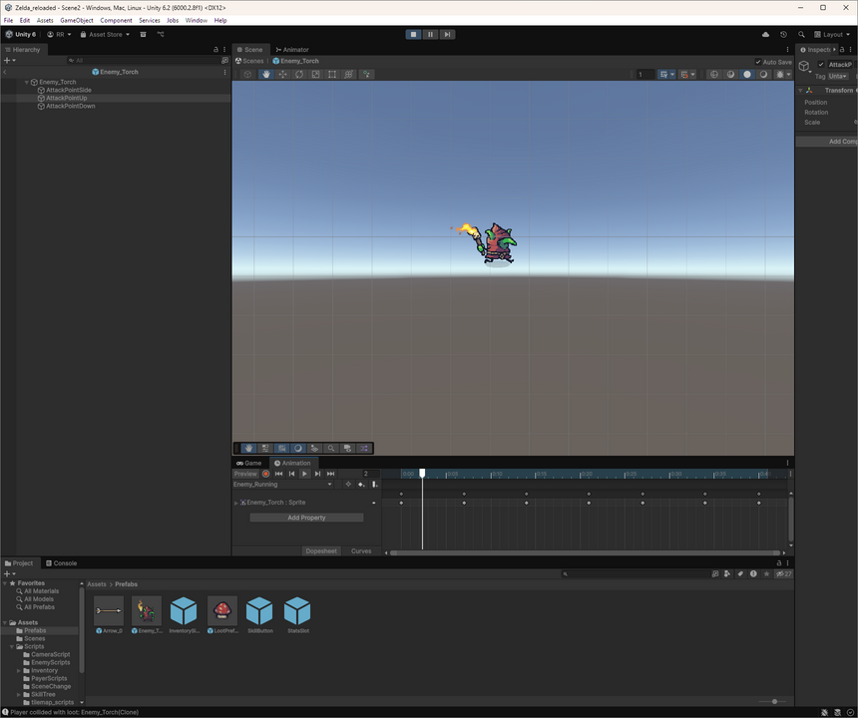
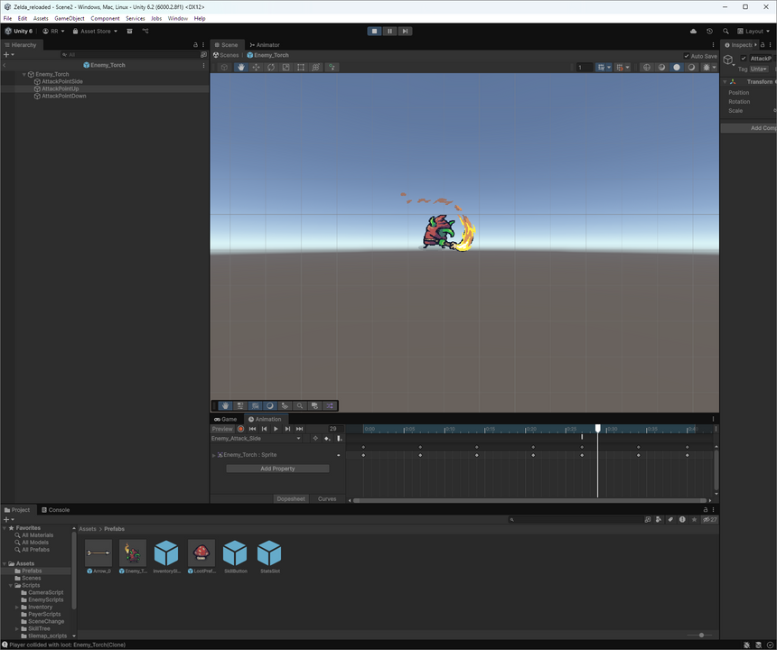
Enemy Behavior
Movement & states
Attack
Damage

Slide 7
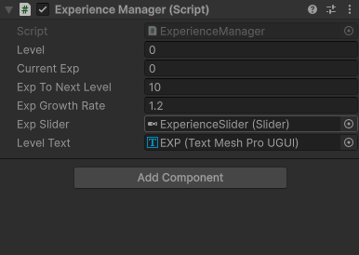
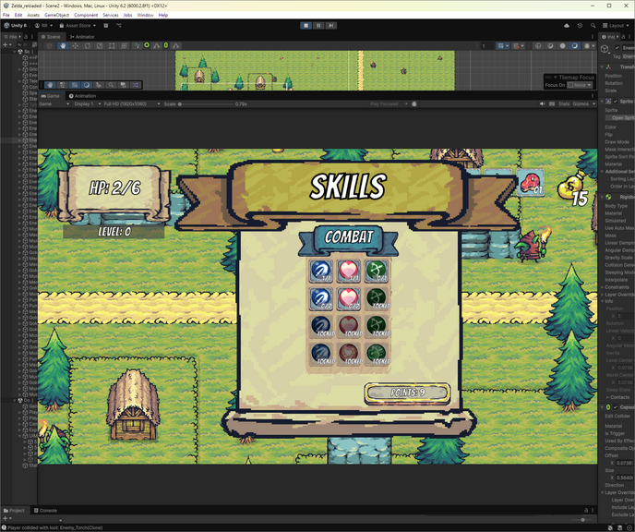
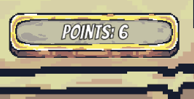
Progression & Skills
Experience Manager
Skill Tree Manager
Point Allocation

Slide 8
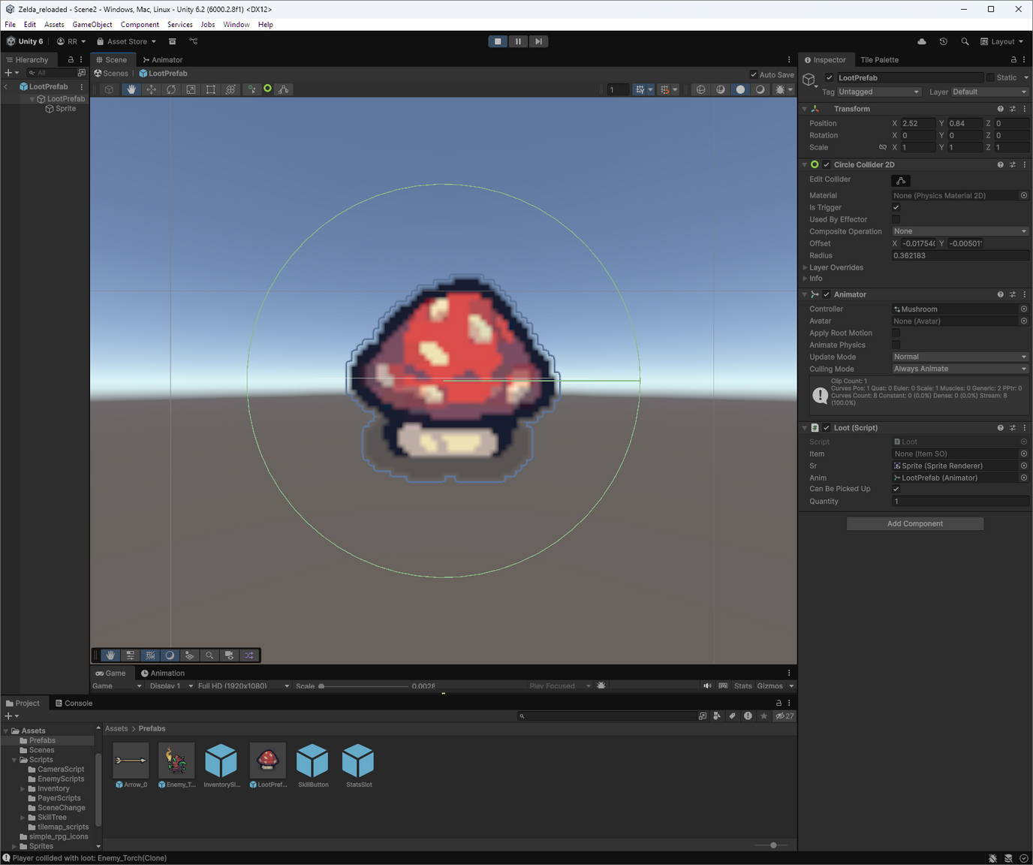
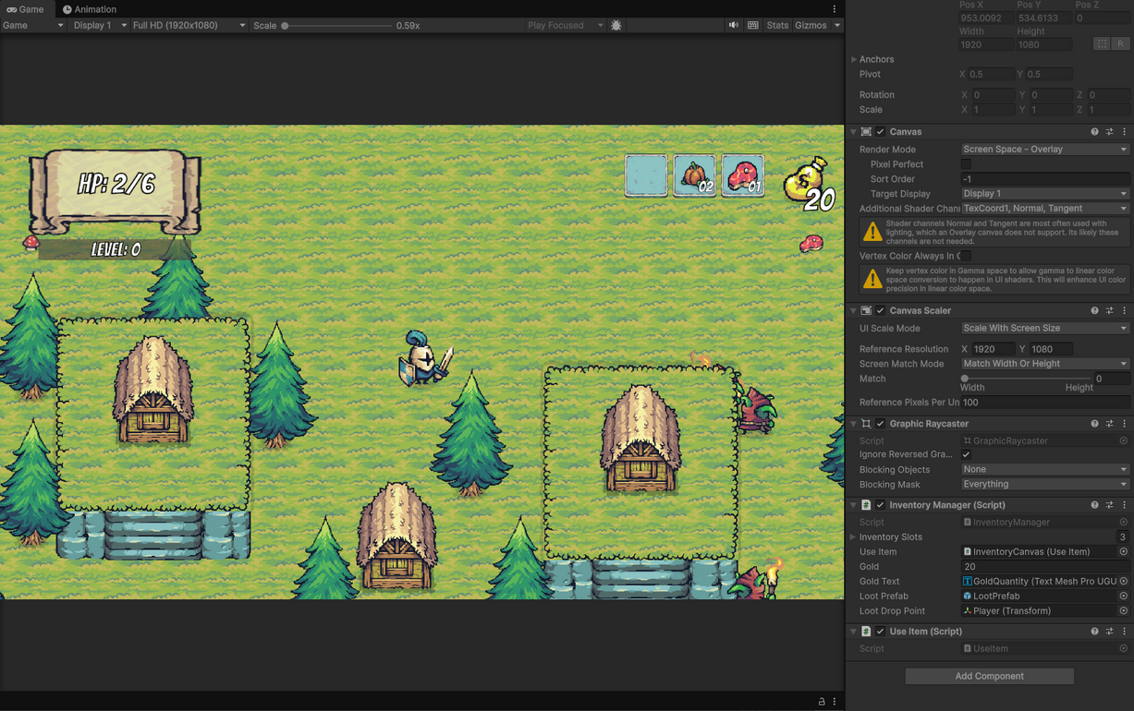
Inventory & Loot
Loot Prefabs
Inventory Managaer
Loot prefabs connect to ItemSO, enabling streamlined pickup notifications
Inventory Manager processes pickup, stacking, use, and drop actions efficiently.

Slide 9
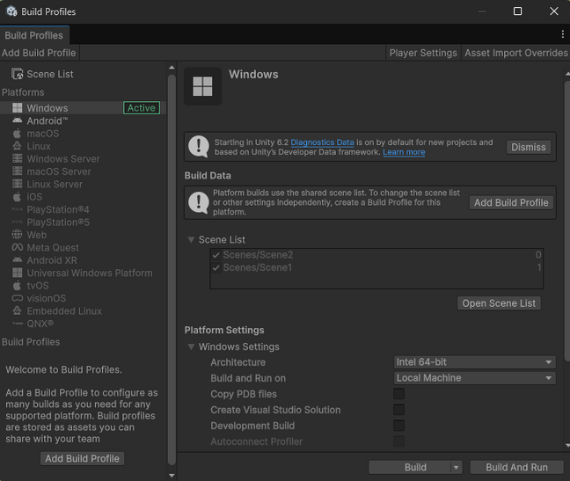
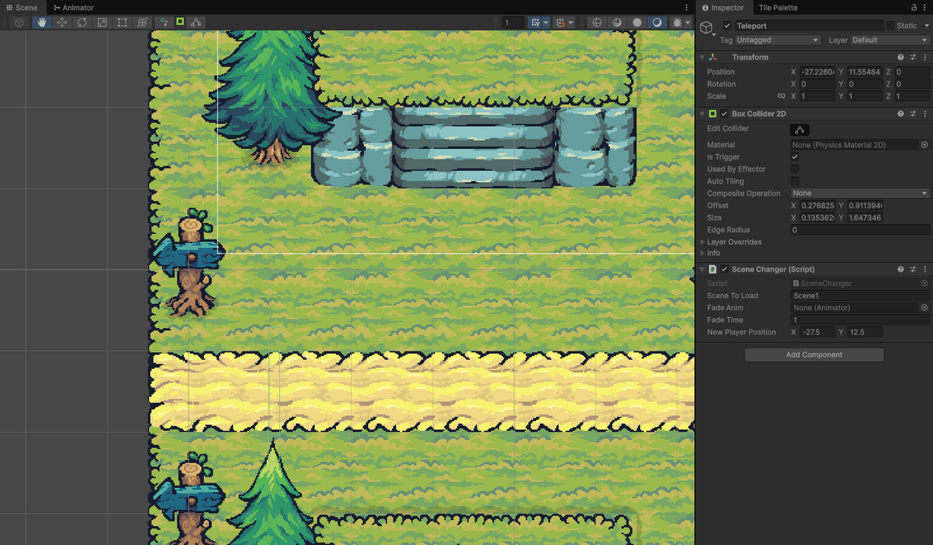
Scenes & Persistence
Scene Changer
Build notes
Handle fades and loading
Include both scenes in Build Settings; test PlayerPrefs reset for consistent demos

Slide 10

Files & Deliverables

Slide 11



Contributions
ROHIT
ADITYA
SHIVA
SUJITH
MANOHAR
CHIRAG
Lead gameplay engineer: movement + combat systems, EXP/skill progression, death/reset flow, and overall integration/debugging. | Show controller/skill tree, walk through scripts, explain architecture decisions.
| UI & spawn helper: set up StatsUI/PlayerHealth/TutorialBanner prefabs, TextMesh Pro styling, and assisted with PlayerSpawner placement. | Highlight tutorial/health banners, stats overlay toggle, and initial spawn flow. |
Enemy helper: duplicated the basic enemy prefab, attached spawn areas, and verified knockback works with default stats. | Spawn enemies live and show they chase/attack using the provided prefab.
Tilemap & elevation helper: painted the maps, placed elevation triggers/bridges, and lined up the Cinemachine confiners.
Inventory helper: wired the inventory UI prefab to ItemSO data, configured loot pickups, and updated gold/quantity text. Open inventory, pick up/drop loot, explain how items show up in slots.
Flow helper: added PlayerPrefs wrappers, the simple GameManager bootstrap, and wired the SceneChanger triggers between both scenes. | Show how high score persists, how GameManager keeps objects, and demo scene swap. |

Slide 12



